Slide 1












Reconstruction of daily air temperature variations globally since the mid 19th century
EUSTACE has received funding from the European Union's Horizon 2020 Programme for Research and Innovation, under Grant Agreement no 640171

Slide 2
Overview
Brief overview of the EUSTACE project:
Aim
Tasks
Observational analysis (one-of-two):
Observation model:
Modelling biases and uncertainties
Air temperature model:
Daily local component
Climatology component
Large-scale component
Examples of preliminary results.

Slide 3
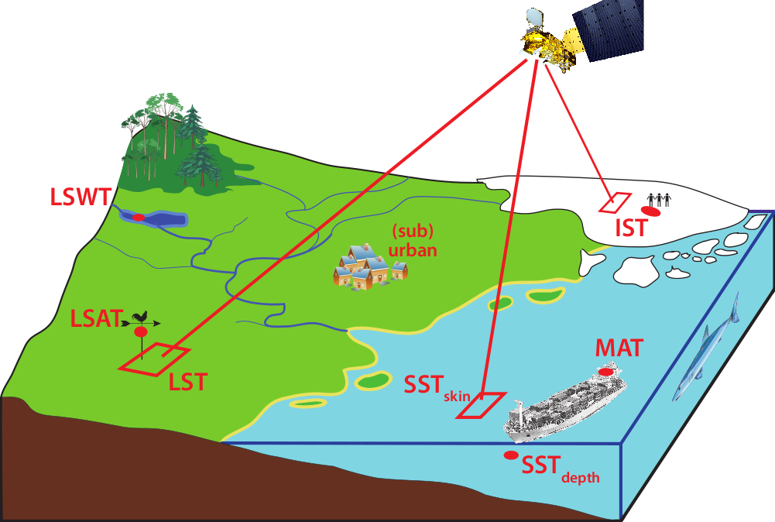
Understand and exploit the Relationship between air and skin temperature
From Merchant et al., 2013 community paper and roadmap:
http://www.geosci-instrum-method-data-syst.net/2/305/2013/gi-2-305-2013.html

Slide 4
WP1: Observation integration
Develop skin-air temperature relationships (over land, sea, ice, lakes).
Quality control observations
Develop observation bias/error models. Breakpoint detection.
WP2: Data set construction
Merge WP1 data products.
Produce spatio-temporal statistical analyses (global, 1850-present).
Develop and build system for dataset construction.
WP3: Validation and intercomparison
Validate WP1 and WP2 products and uncertainty estimates against independent reference data.
WP4: Outreach and dissemination
WP5: Science leadership
WP6: Project management

Slide 5
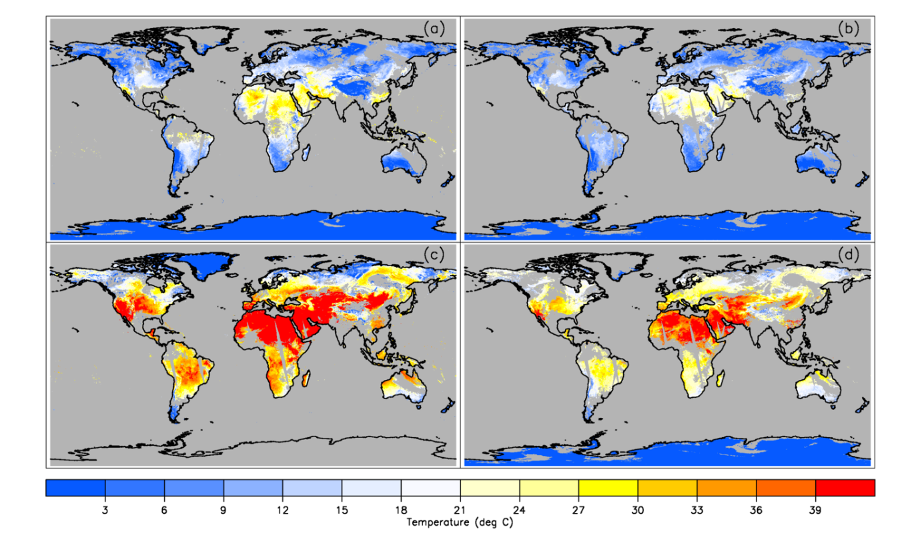
Example satellite derived 2m air temperature (1 July 2010)
Tmin
LST Night
Tmax
LST Day

Slide 6
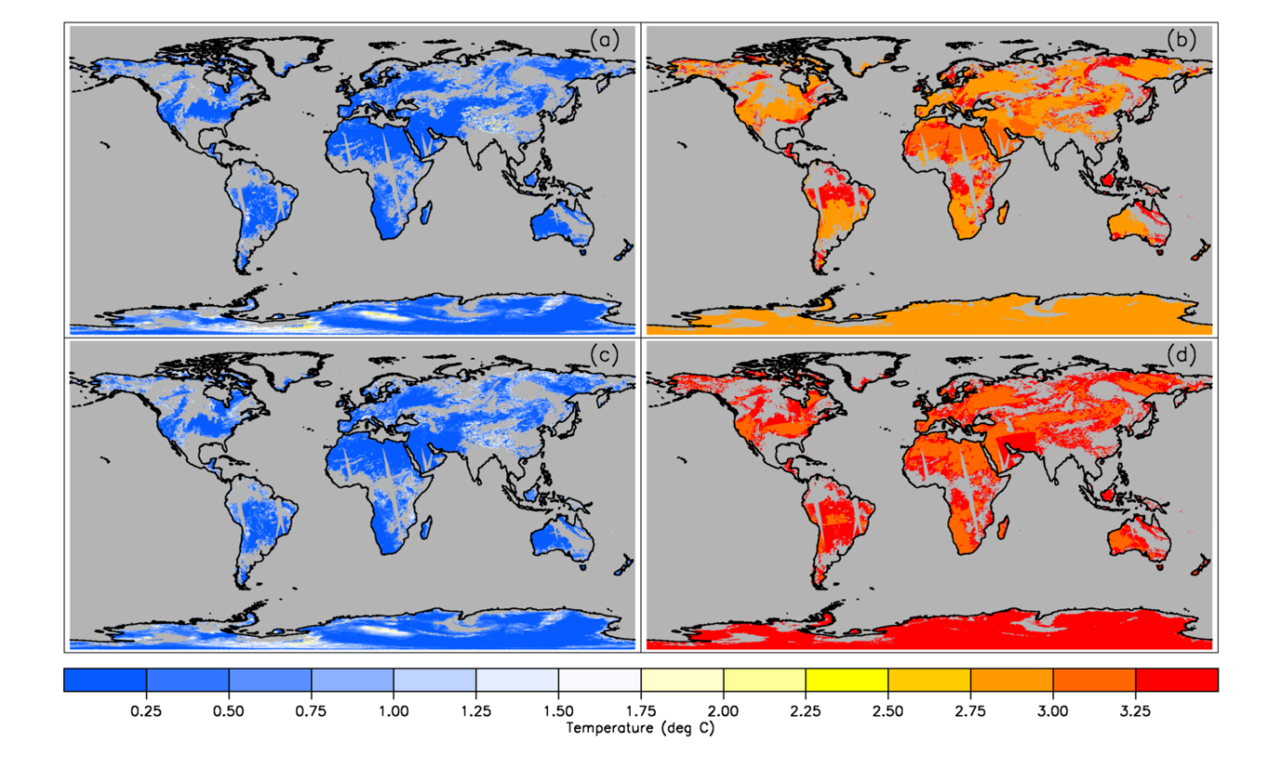
Example Uncertainty Fields (1 July 2010)
Tmin_{random}
Tmin_{local}
Tmax_{random}
Tmax_{local}

Slide 7
Sources of observational uncertainty
Satellite observations over land, sea, ice:
Structural errors: brightness temperature calibration, conversion to air temperature, observed surface related.
Correlated errors: atmospheric corrections, surface emissivity errors.
Uncorrelated errors: sensor noise, geolocation.
In situ observations from weather stations, ships, buoys.
Structural errors: observing platform specific biases, instrumentation changes calibration, station siting changes.
Uncorrelated errors: observational noise, local representivity.

Slide 8
An Empirical Land Surface temperature – air temperature relationship
Build multiple linear regression model using weather stations and satellite Land Surface Temperature observations, together with other explanatory variables.
T_{max}=α₀+ α₁.LST_{day} + α₂.LST_{ngt}+ α₃.FVC + α₄.DEM + α₅.SZA_{noon}+ α₆.Snow + ε_{Tmax}
T_{min}=β₀+ β₁.LST_{day} + β₂.LST_{ngt}+ β₃.FVC + β₄.DEM + β₅.SZA_{noon}+ β₆.Snow + ε_{Tmin}
Air Temperature
Vegetation fraction
Elevation
Solar Zenith angle at noon
Error
Satellite observed LST (day/night)
Notes:
FVC = Fraction of Vegetation Cover
DEM = Digital Elevation Model

Slide 9
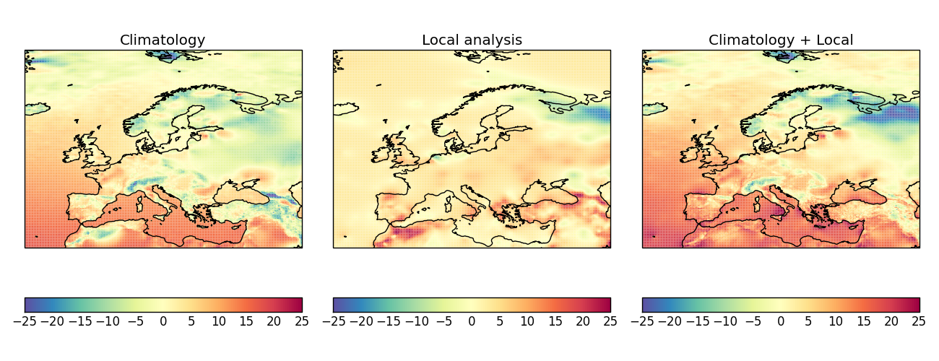
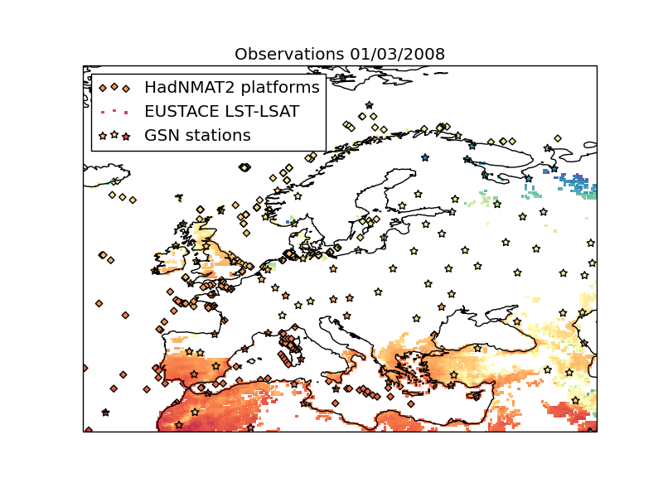
Analysis system Aim
Construct a spatially and temporally complete analysis of global air temperatures from 1850 to present with validated uncertainty estimates, constructed from satellite and in situ data sources.
Notes:
spatially and temporally complete
uncertainty estimates
satellite and in situ data sources -> error models for all inputs!
9

Slide 10
Comments on scale
Output resolution = 0.25 degree latitude/longitude grid
= 1,036,800 output locations per day
Number of days > 60,000
Three variables: maximum, minimum and mean temperatures
Ensemble output – small number of samples of whole dataset to sample uncertainty in analysis.
Full space-time statistical model solve requires big computing (this is also being investigated in the project in a second analysis approach).
The approach discussed today takes a different route, splitting the problem into smaller, solvable chunks. Many similarities in modelling.

Slide 11
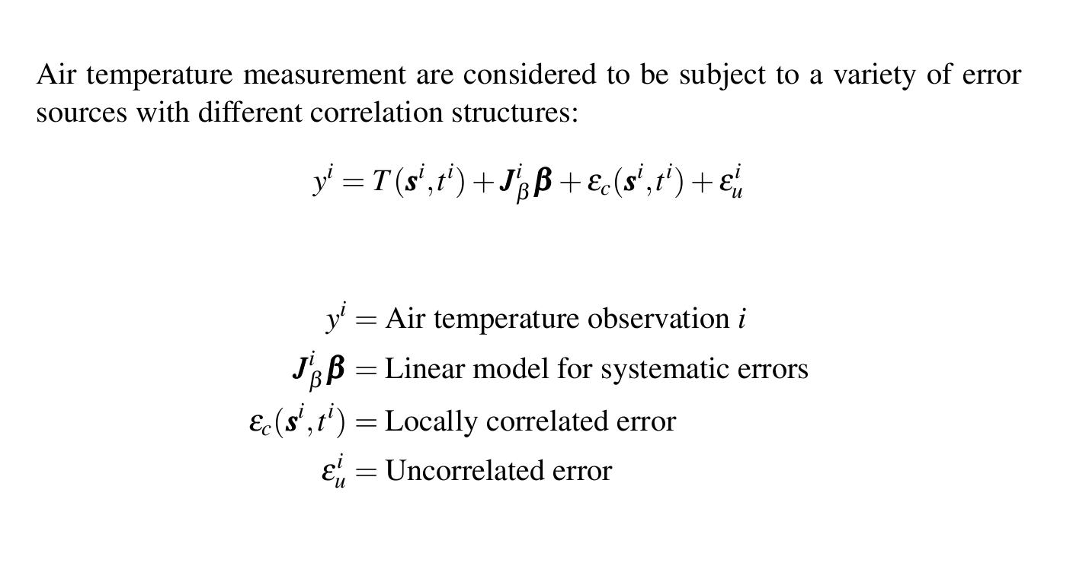
Observation model
Notes:
11

Slide 12
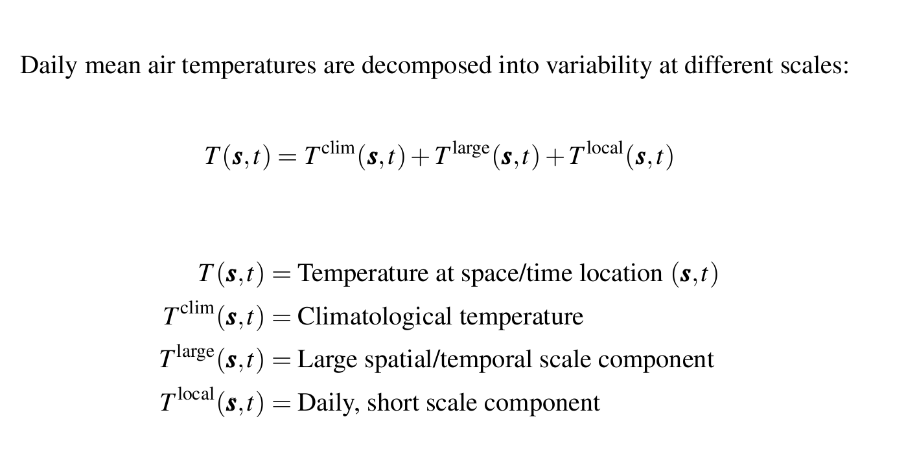
process model
Notes:
12

Slide 13
Model component: Daily local analysis
Independent, daily analyses of a spatial smooth temperature field.
Use SPDE approach (Lindgren et al 2011):
Describes smooth function as weighted sum of local basis functions.
Smoothness - Gaussian Markov Random Field prior weights. Smoothness controlled by parameters of the prior precision matrix.
Objective of estimation is to learn the probability density function of the coefficients conditioned on the data.

Slide 14
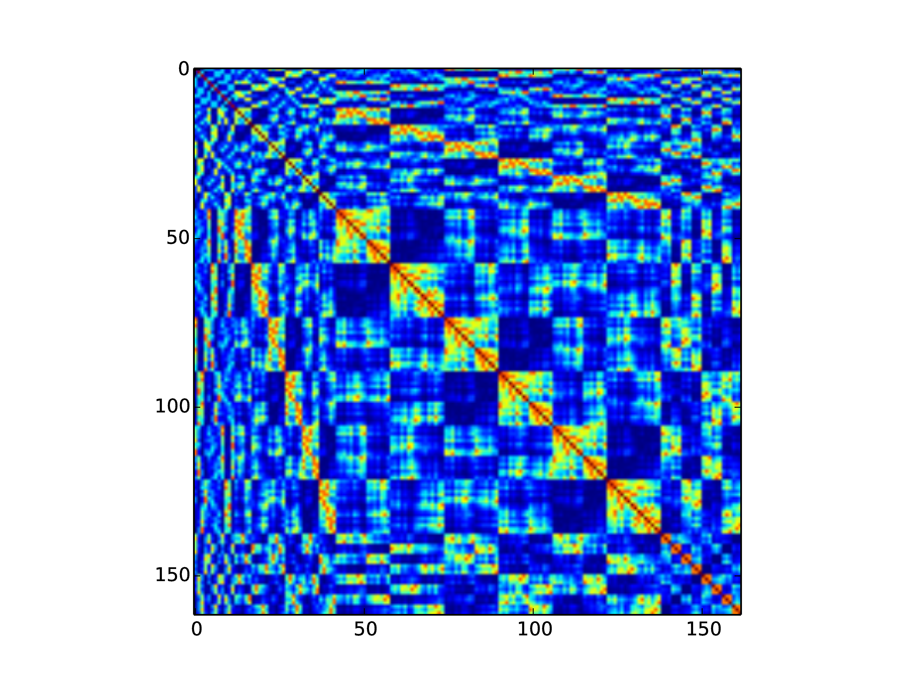
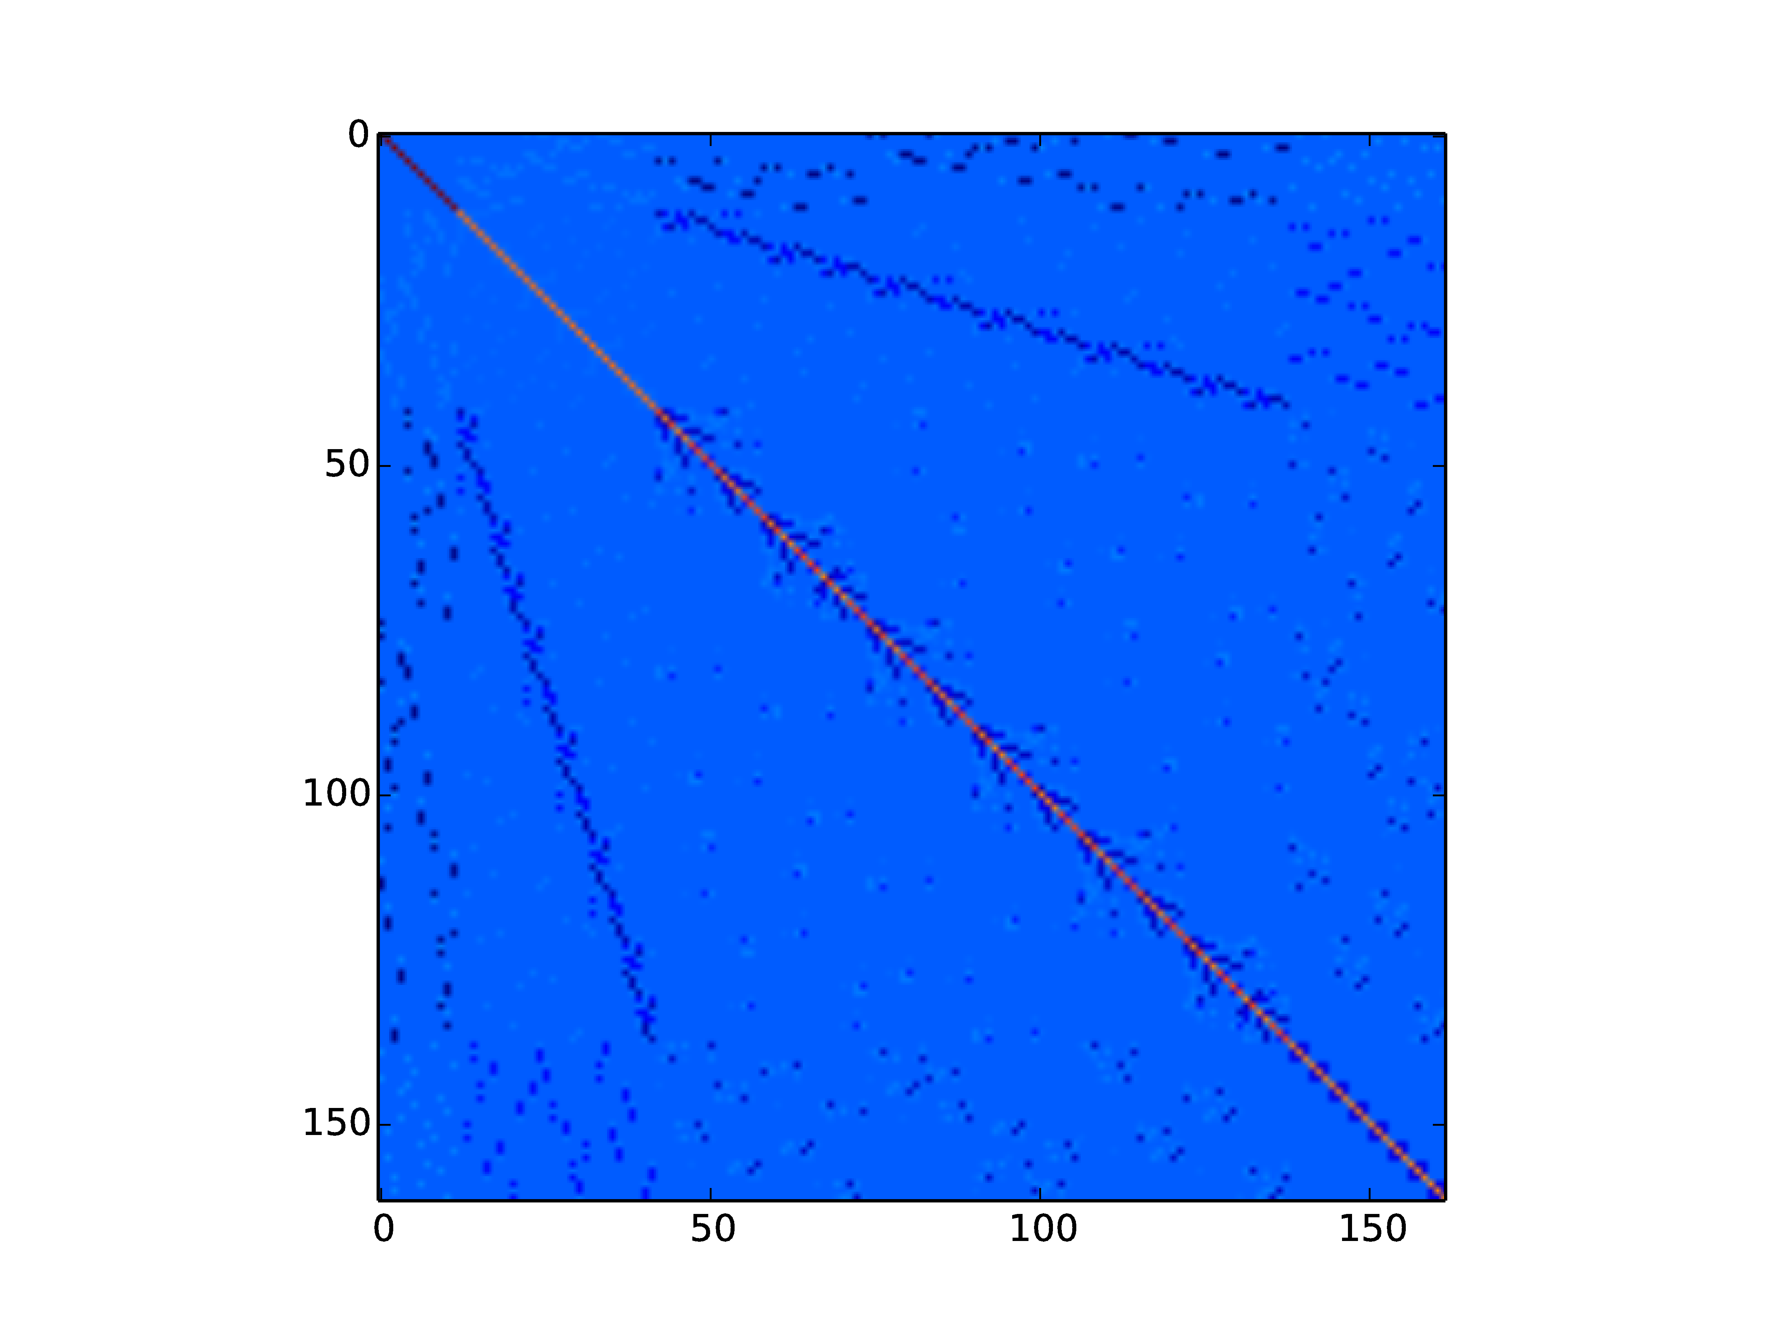
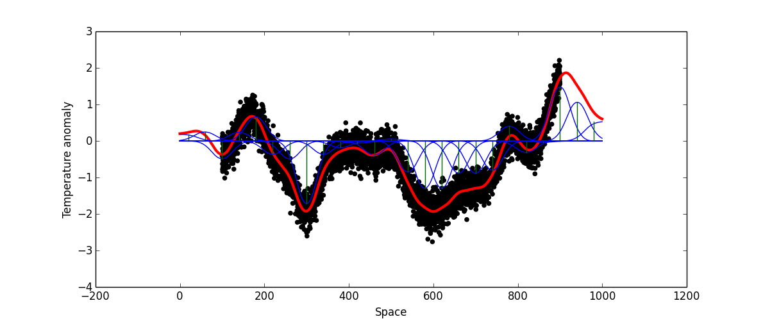
From covariance functions to spde models
Traditional Kriging is not feasible for data volumes in EUSTACE.
(Requires solutions to linear systems involving big, dense covariance matrices)
Lindgren et al. (2011) result allows much more efficient computation.
(Can directly compute sparse inverse covariance matrices corresponding to Matérn covariance functions)
Dense covariance matrix
Sparse inverse covariance matrix (lots of zeros)
Basis functions on grid with SPDE weights (Nychka et al., 2015)

Slide 15
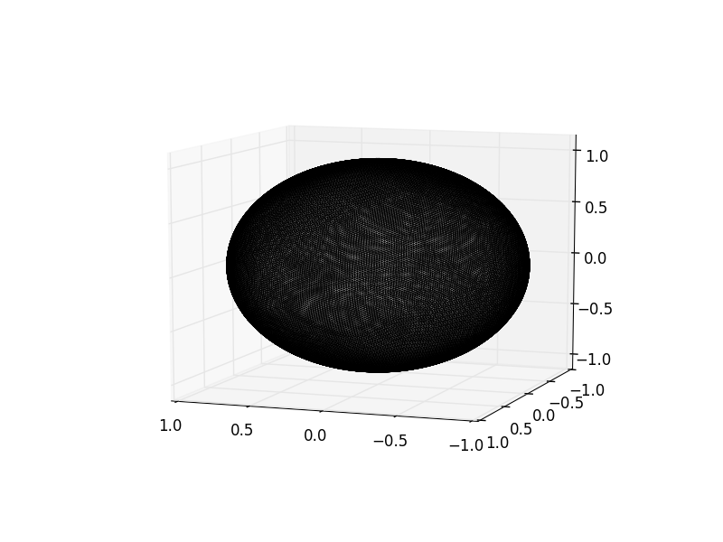
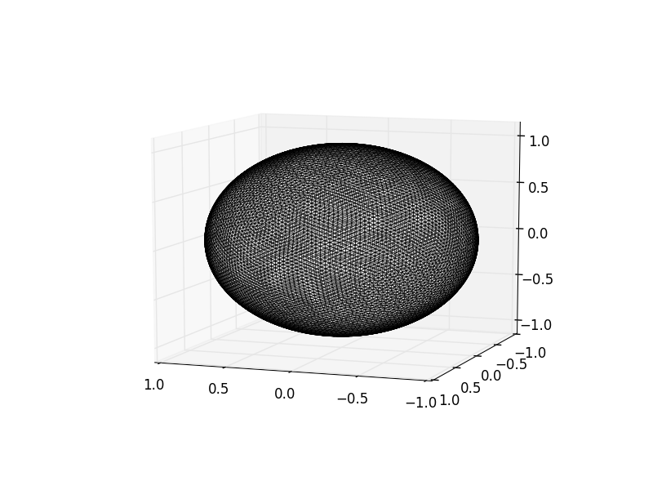
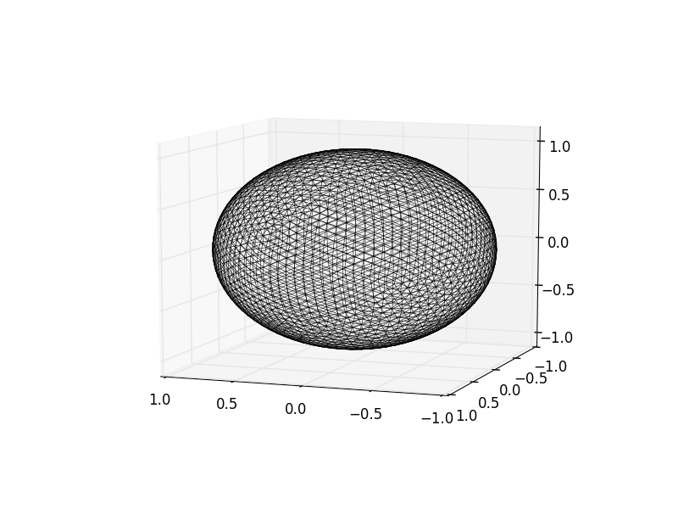
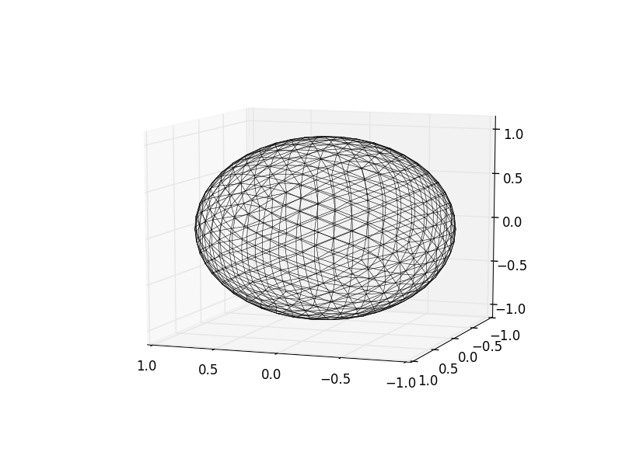
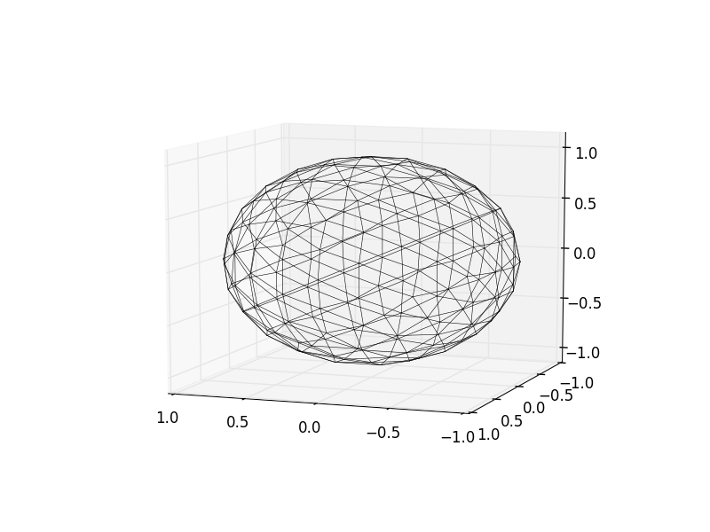
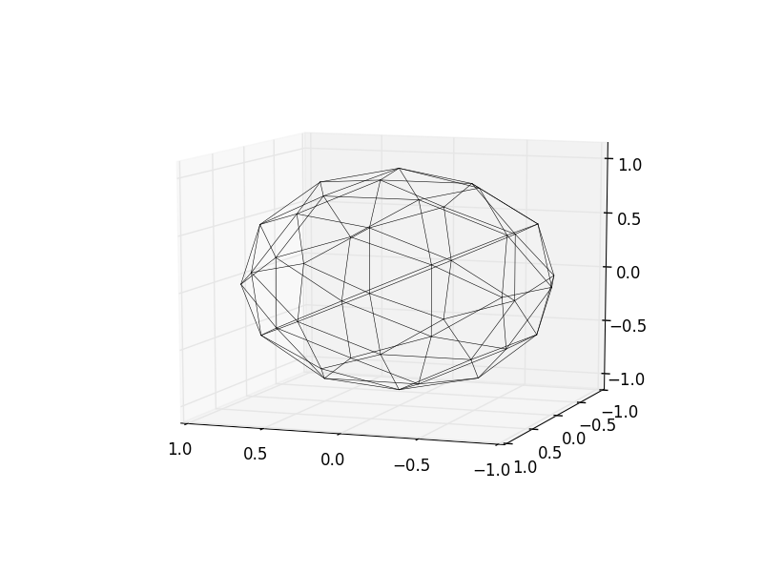
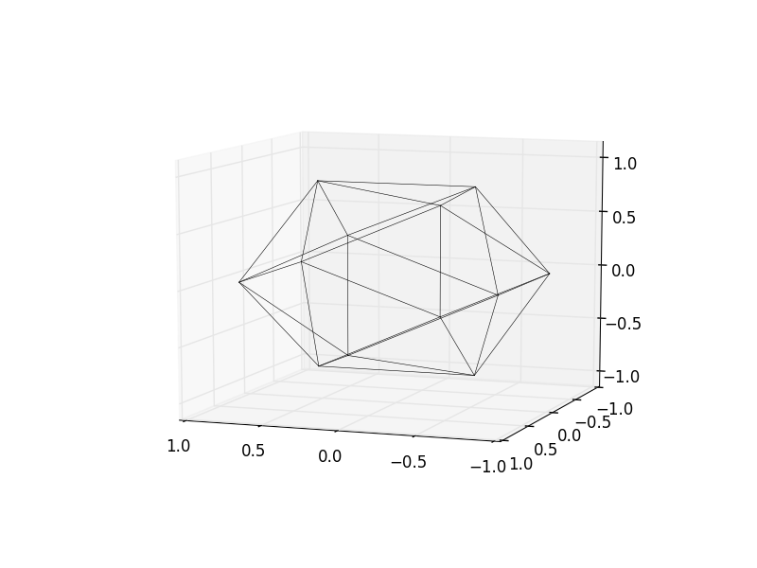
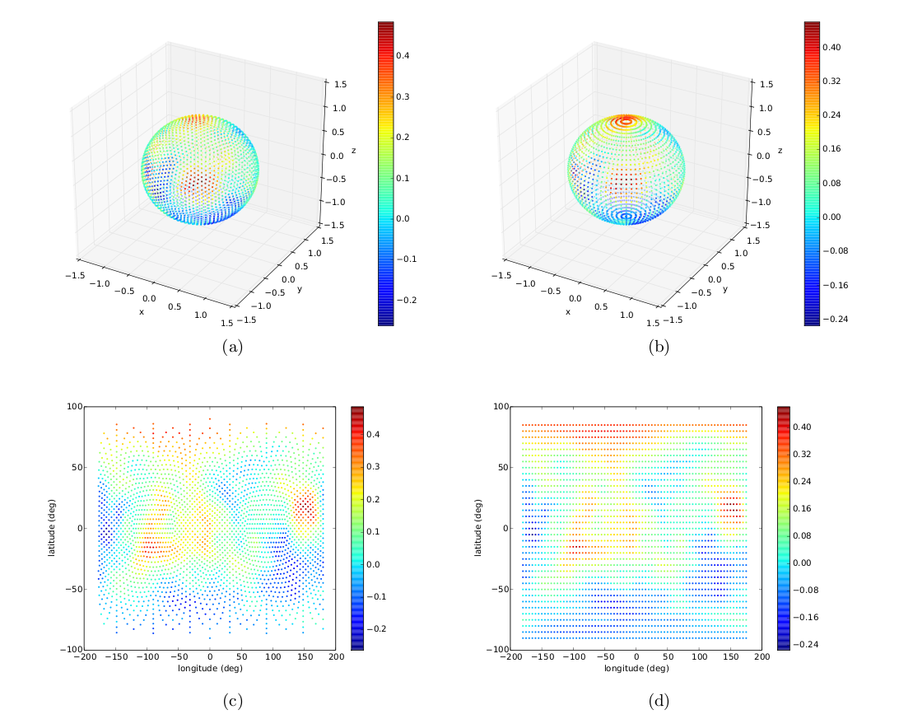
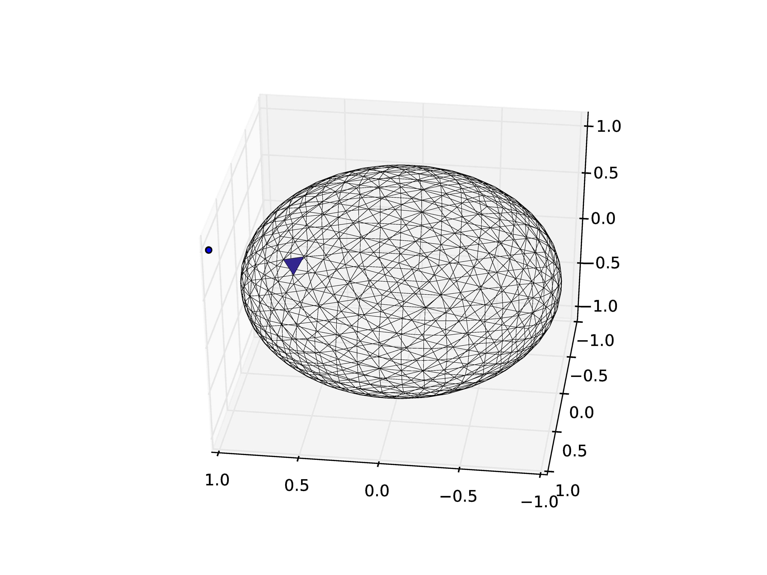
Random processes on spheres

Slide 16
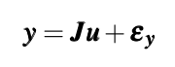
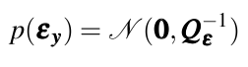
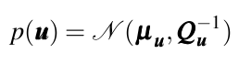
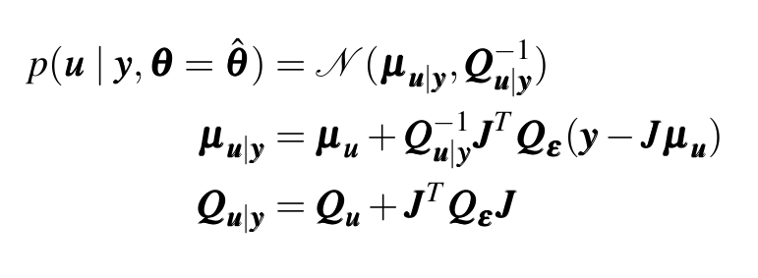
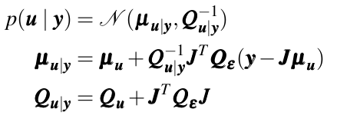
Estimation through conditional gaussians
Model:
Construct a design matrix J to form a linear observation equation as:
Observations are subject to Gaussian measurement error:
Latent variables u have Gaussian prior distribution:
Estimation:
Compute the distribution of u conditioned on the observations:

Slide 17
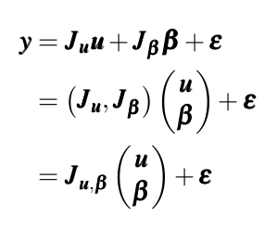
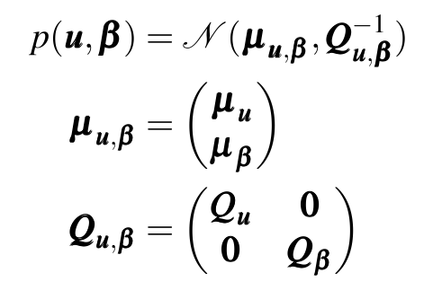
Joint estimation of biases
The design matrix describes the structure of systematic errors.
The unknown vector β controls the magnitude of systematic error
Append observation bias variables β onto model variable vector u and estimate jointly.
Joint prior:
Notes:
17

Slide 18
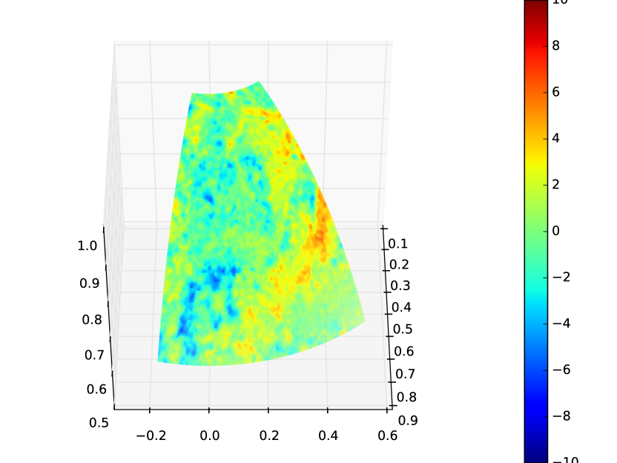
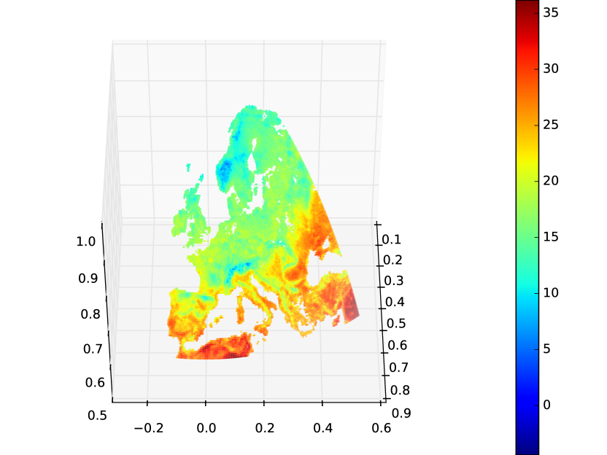
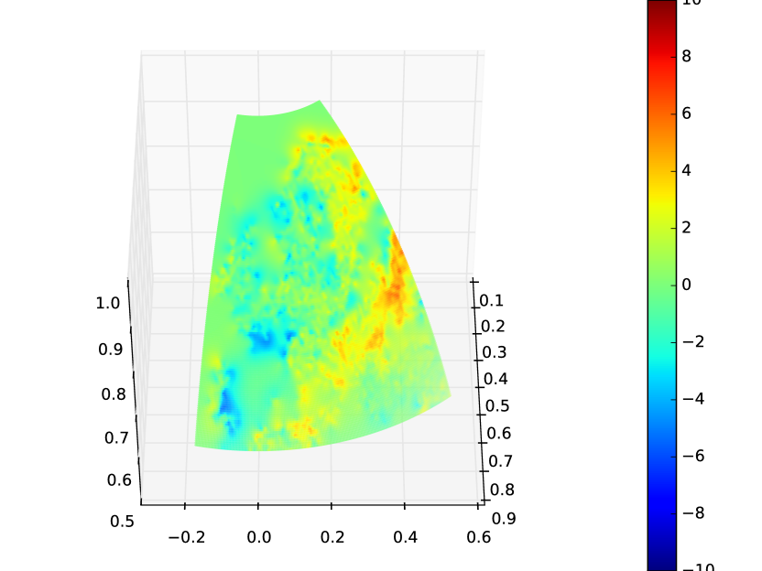
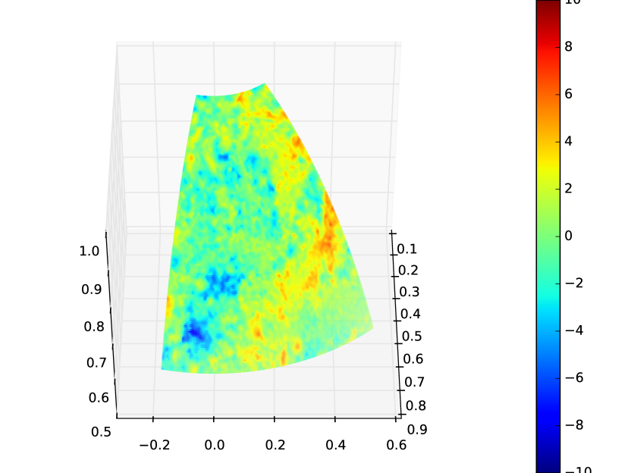
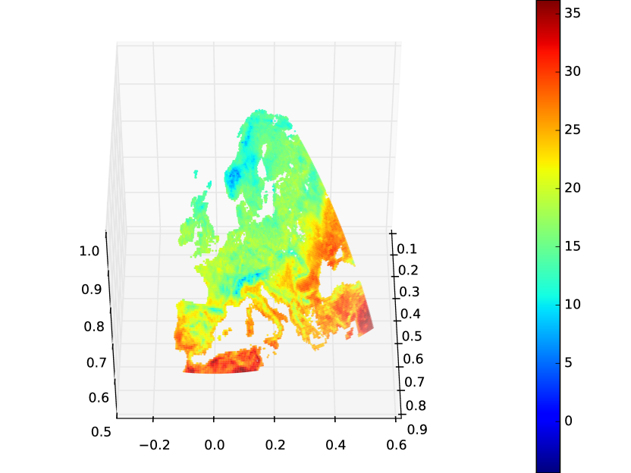
Ensemble generation
Aim to produce a dataset that can be used to undertake scientific analysis, including assessment of uncertainty.
To this end, multiple realisations of the dataset will be produced through conditional simulation.
Combine with other model components
Conditional simulation
Notes:
18

Slide 19
Single variable analysis model: Mean/max/min Temperature
Strategy for solution:
Decompose the space-time temperature field into components with defined structure in space/time:
Append bias variables onto model components and estimate jointly.
Solve each component conditioned on the expected value of other components.
Refine solutions by iteratively re-estimating each component.
Notes:
19

Slide 20
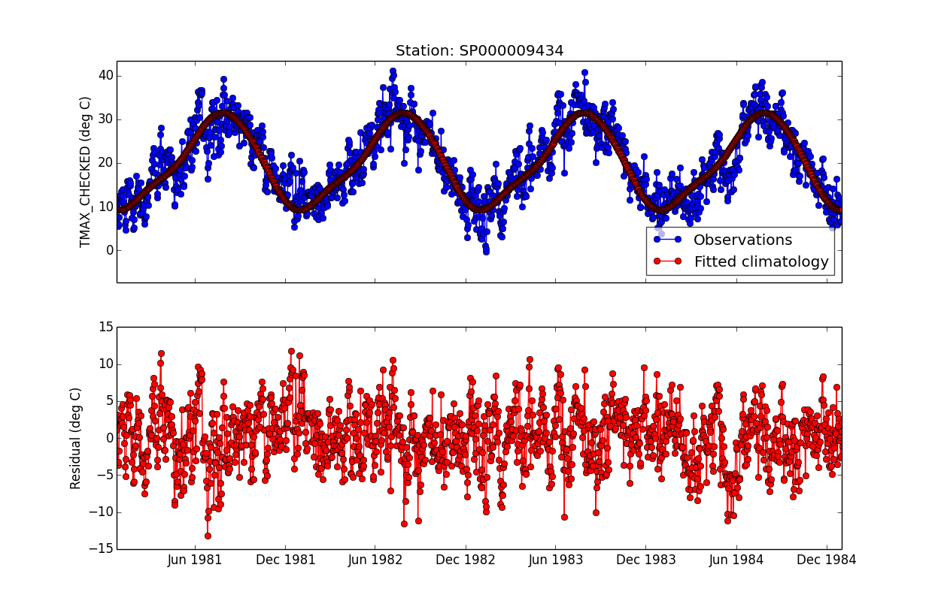
Climatology
Climatology = Covariates (e.g. altitude, latitude) + Seasonal component
Seasonal component constructed as Fourier series in time.
Fourier series coefficients varying smoothly spatially.
Spatial fields of coefficients are constructed as a weighted sum of spatial basis functions. The weights are modelled as latent variables with GMRF priors.

Slide 21
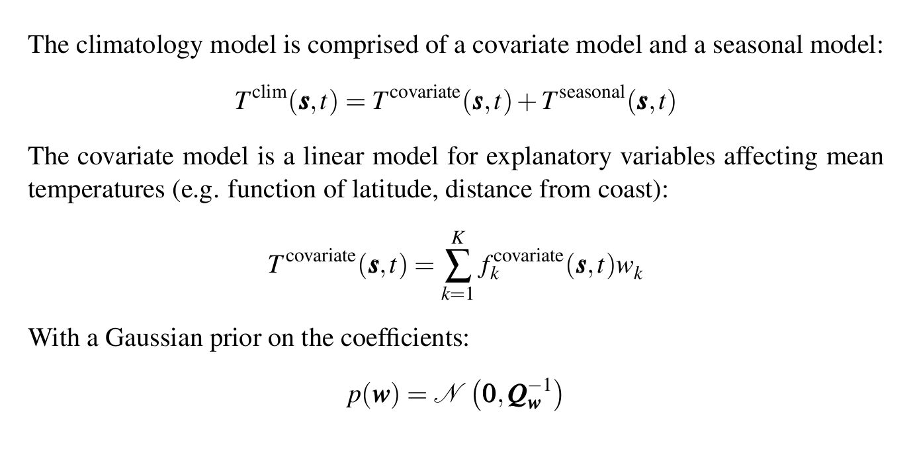
Component: Climatology
Notes:
21

Slide 22
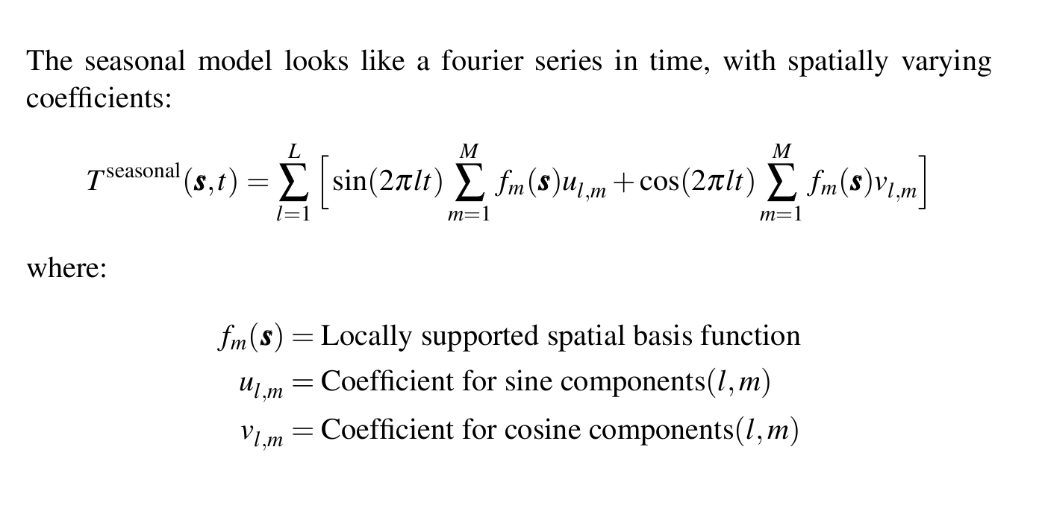
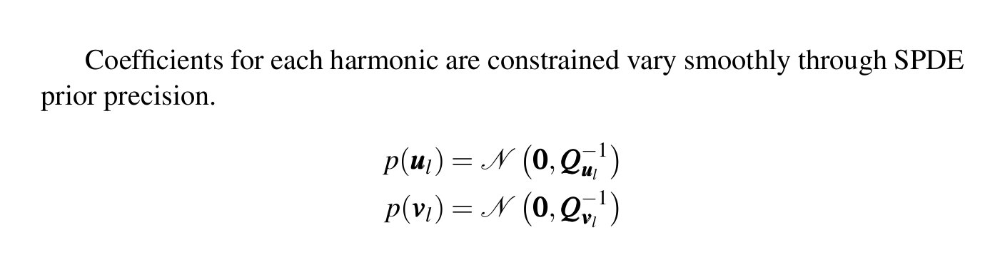
Component: Climatology
Notes:
22

Slide 23
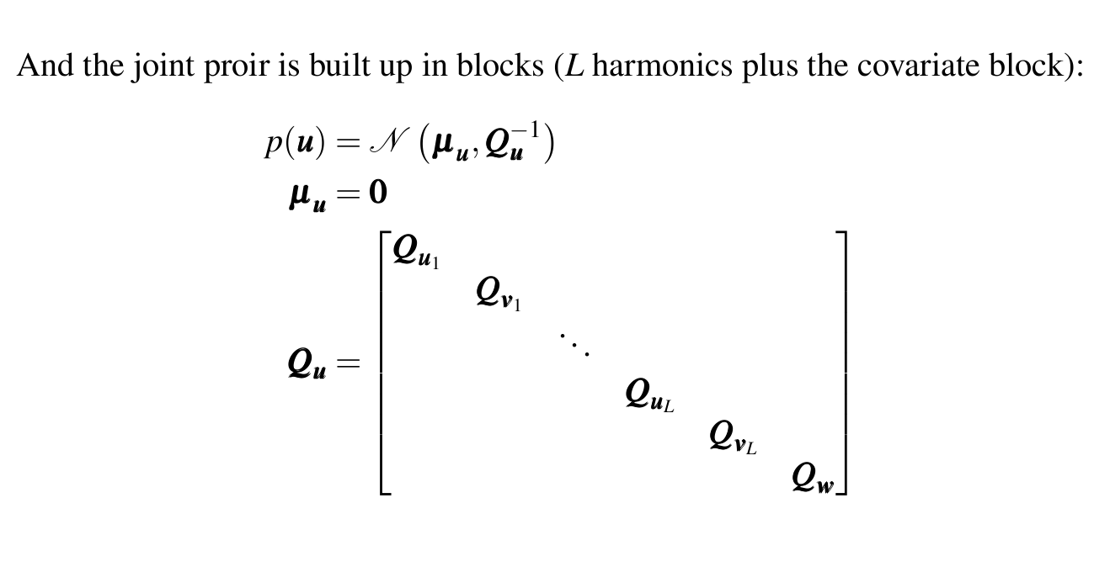
Climatology component
Notes:
23

Slide 24
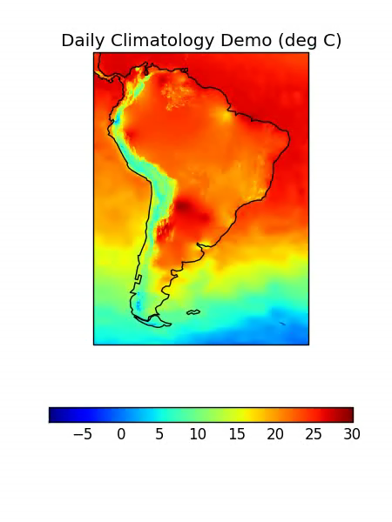
Model component: climatology
Seasonal component
Local Harmonic | Temporally harmonic, spatially local basis functions.
Local Offset | Temporally constant, spatially local basis functions.
Covariate component
Grand mean | Constant offset for whole globe.
Harmonics of latitude | Accounts for temperature variation with latitude. Spatially harmonic.
Altitude | Spatially local variation in mean temperature with altitude.
Distance from water | Coastal effect for large water bodies.
Climatological surface type | Indicators of surface type (e.g. water, ice, vegetation)
Notes:
24

Slide 25
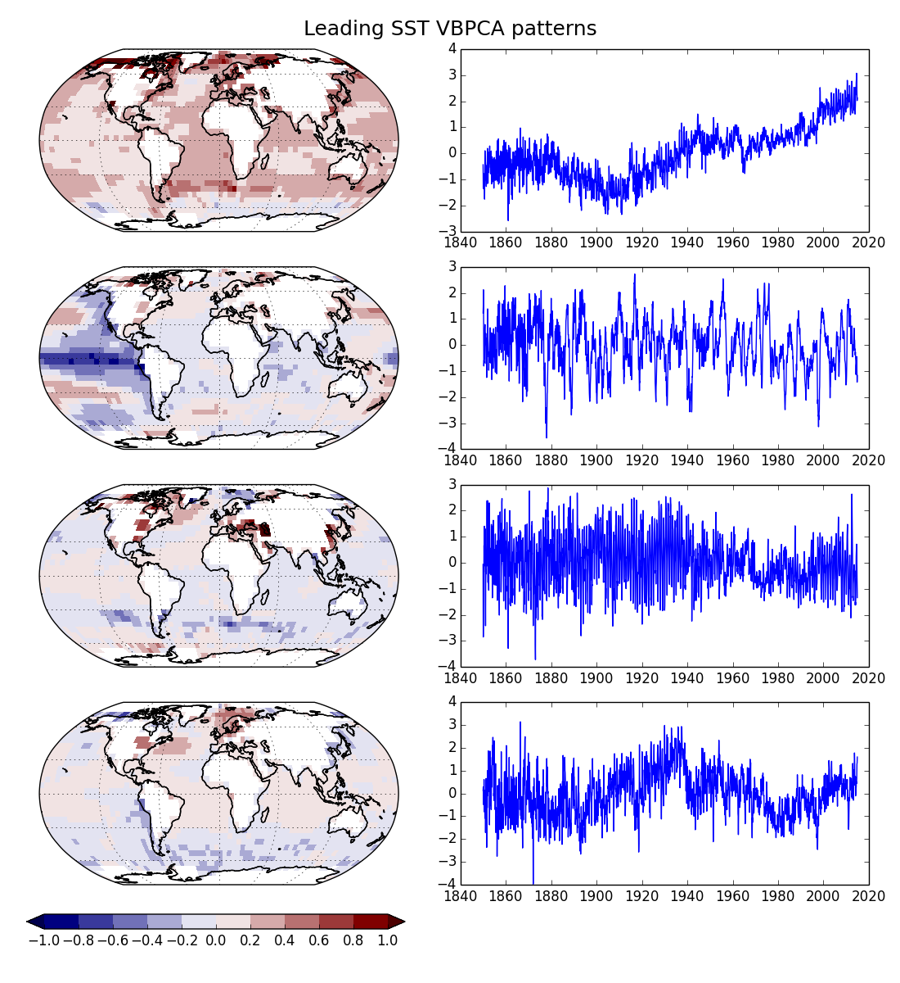
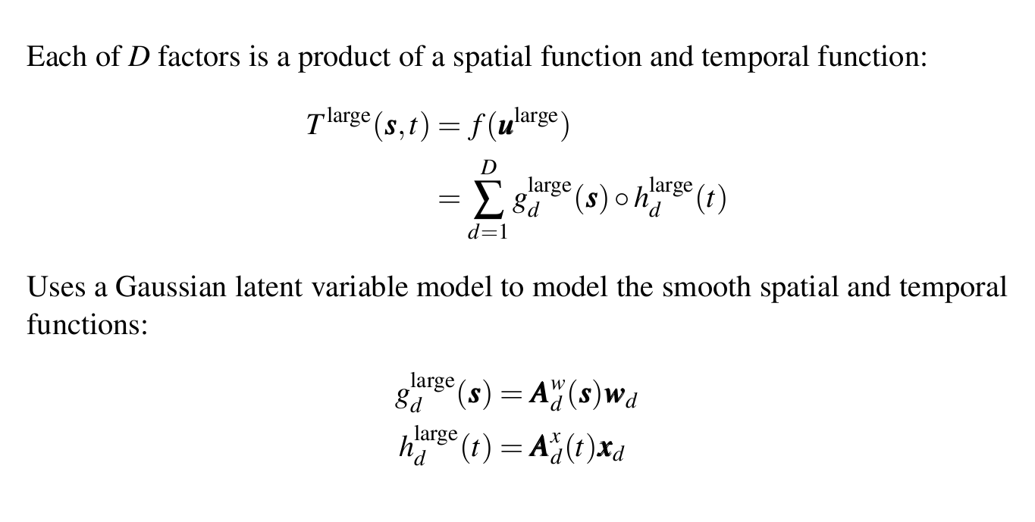
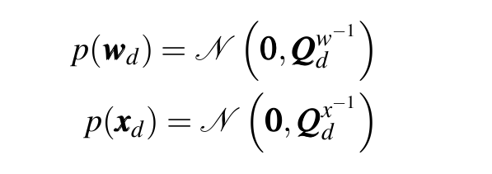
Component: LARGE SCALE
Nonlinear model: products of spatial and temporal components:
Spatial and temporal functions formed as SPDE models:
With Gaussian priors on the latent variables:
Notes:
25

Slide 26
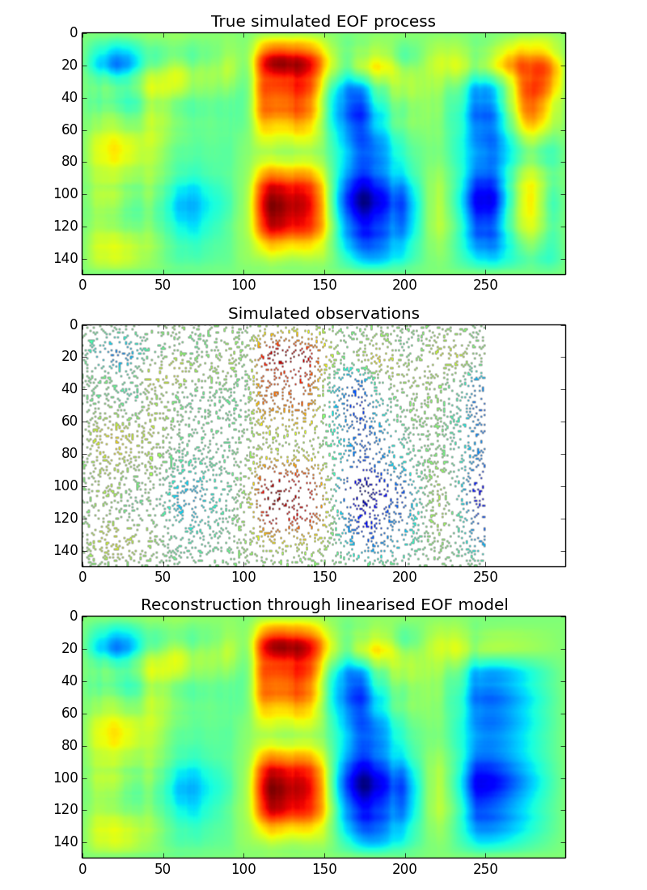
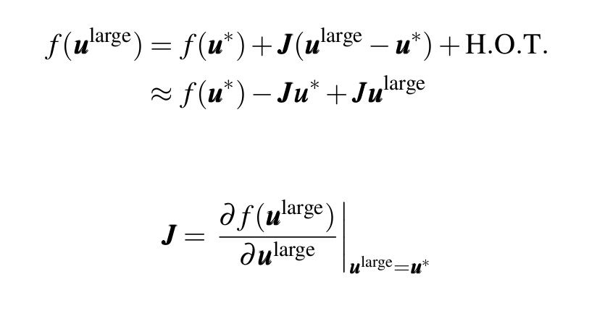
Model component: large scale analysis
Nonlinear model: products of spatial and temporal components:
Form linear approximation through Taylor expansion:
Space
Time
Then use methods for linear Gaussian model for estimation.

Slide 27
Analysis Prototype climatology/local component
Applied to in situ NMAT/SAT & LSAT derived SAT:
Fitted climatology – spatial SPDE’s for coefficients of Fourier components in time.
Fitted local – daily spatial SPDE.
Climatology used observations in 1961-1990 period.
Currently extending to include all model components.

Slide 28
summary
Aim:
Produce a globally complete daily temperature analysis with validated uncertainties.
Approach:
Draws heavily on Gaussian latent variable models.
Split model into climatology, large-scale and daily local components.
Extensions:
Non-stationary processes (linear model for precision matrix parameters – amplitude and decorrelation range e.g. a function of distance from coast)
Diurnal temperature range model (transformed Gaussian model).

Slide 29
Questions?
EUSTACE has received funding from the European Union's Horizon 2020 Programme for Research and Innovation, under Grant Agreement no 640171

Slide 30
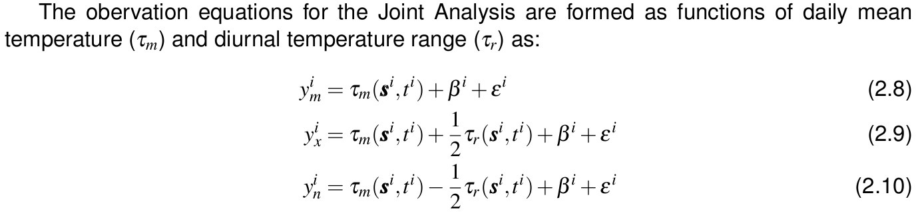
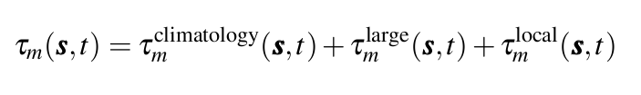
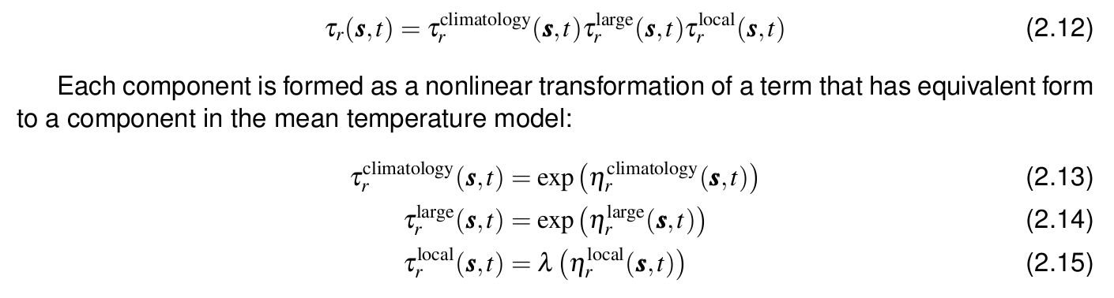
Joint analysis model: Mean Temperature and DTR
Tmean decomposed as sum of sub-components (as before):
DTR decomposed as product of strictly positive sub-components:

Slide 31
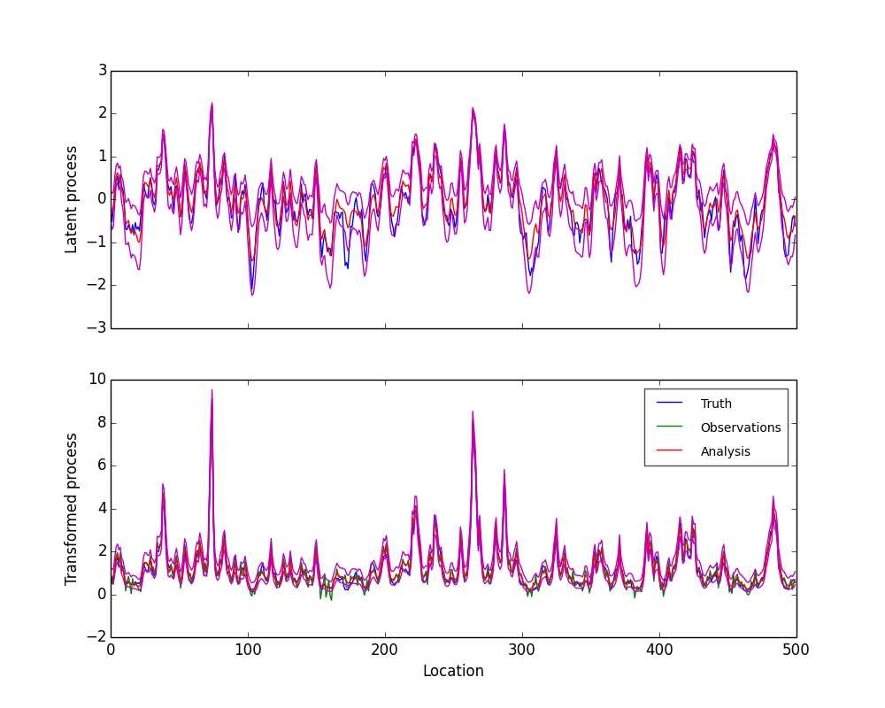
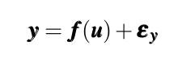
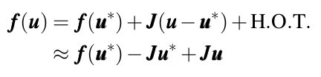
Joint analysis model: Mean Temperature and DTR
Approximate solution through Taylor expansion of observation equation:
Analysis example (exponential transform)
Can now solve using methods for linear Gaussian model. Iteration is required to refine linearisation set point.

Slide 32
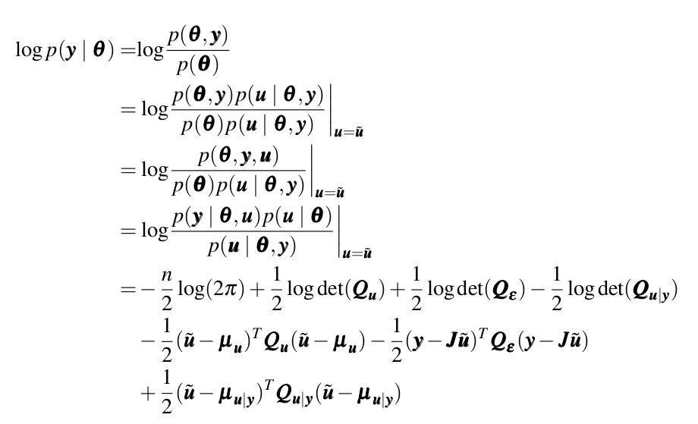
Linear gaussian model
Parameter estimation:
The prior precision matrix on u has parameters to be optimised.
Optimise the parameters to maximise conditional marginal log likelihood:
Will be optimised on subset of data before running the full analysis.

Slide 33
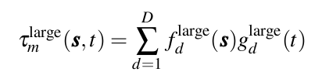
Model component: Large-scale
General form: A sum of D processes. Each defined as a product of a spatial and temporal process.
Spherical harmonic option (linear):
Spatial spherical harmonic pattern
Temporal smooth process to estimate – SPDE approach.
Factor analysis option (nonlinear): :
Spatial smooth process to estimate – SPDE approach.
Temporal smooth process to estimate – SPDE approach.

Slide 34






1. Spherical harmonic model
The analysis is formed as a weighted sum of spatial spherical harmonics.
Time series of pattern weights are estimated using the SPDE approach.
A linear model where each basis function is formed as the product of:
A spherical harmonic spatial pattern.
A function with local influence in time.
Spherical harmonic patterns
Smooth pattern time series

Slide 35






2. Factor analysis model
The analysis is formed as a weighted sum of spatial patterns that are now learnt from the data.
Similar to VBPCA but uses SPDEs for both the spatial patterns and time series.
Based on Gaussian Process Factor Analysis (GPFA) (Luttinen & Ilin, 2009). Modified to use SPDEs and include observational errors.
Iterative – flips between estimation of spatial and temporal SPDEs.
Too computationally expensive.
Tests of the prototype SPDE-FA decomposition applied to global air temperature data
(3 components)
Notes:
Luttinen, J. and Ilin, A. (2009). Variational Gaussian-process factor analysis for modeling spatio-temporal data. In Advances in neural information processing systems, pages 1177–1185.

